Slide 1

Predicting severity of Accidents
By using Data analysis, data Visualisation and machine learning

Slide 2
Importance of predicting severity of accident
When Infrastructural planner and builder knows the infrastructural factors of severity of accidents, they can build safe city road infrastructure
Situational factors of accident help people to reschedule their time of travelling to lessen the probability of encountering the sever accidents.
Similarly, by knowing the environmental factors of accidents like rain and lighting conditions, traveller can plan better.

Slide 3
Data acquisition and cleaning
Accident data is downloaded from the coursera source.
The data set have 194673 rows and 38 columns.
Duplicate, highly similar or highly correlated features were dropped.
Day of week and the hour of accident is extracted from the datatime of the accident
Severity have two values-1 and 2 and they are imbalanced. Therefore, some rows are randomly dropped to make data balanced.

Slide 4
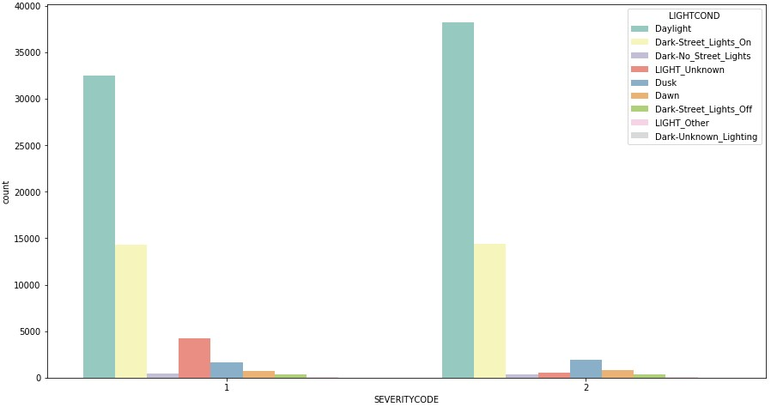
Relationship between Lighting condition and severity of accident

Slide 5
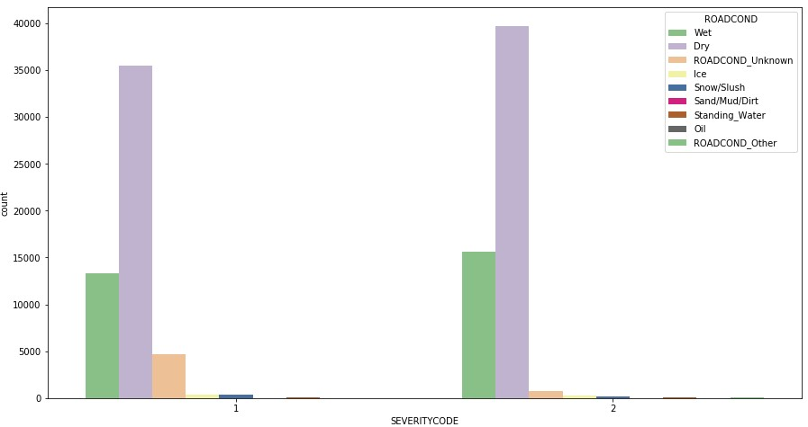
Relationship between Road condition and severity of accident

Slide 6
Relationship between weather condition and severity of accident

Slide 7
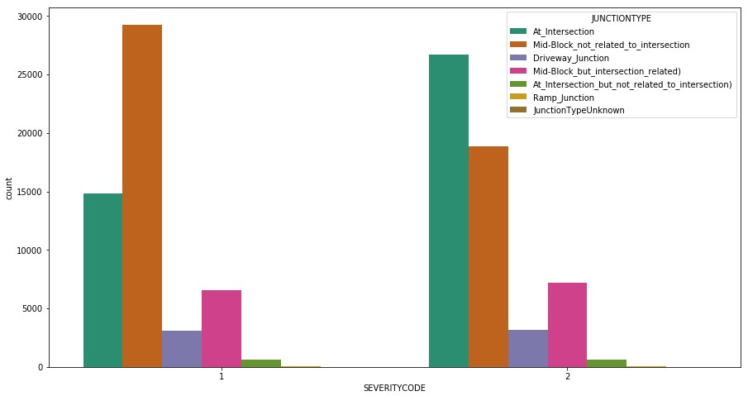
Relationship between Junction type and severity of accident

Slide 8
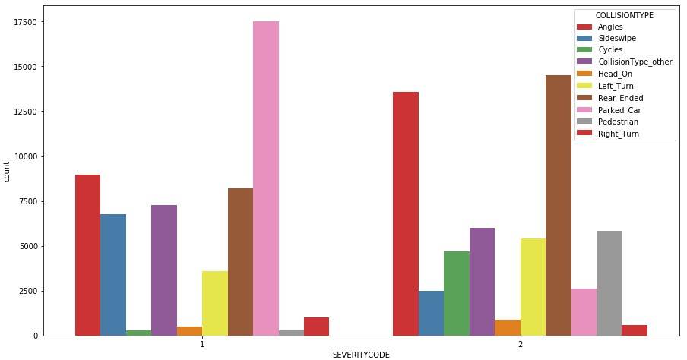
Relationship between Collision type and severity of accident

Slide 9
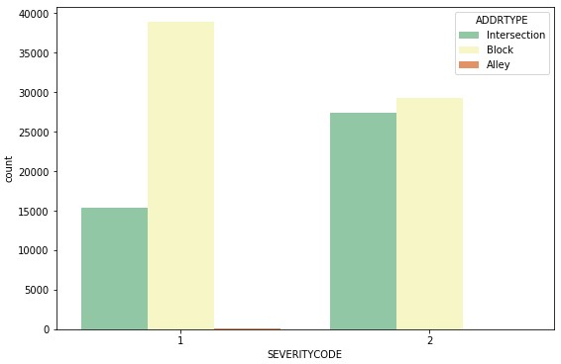
Relationship between address type and severity of accident

Slide 10
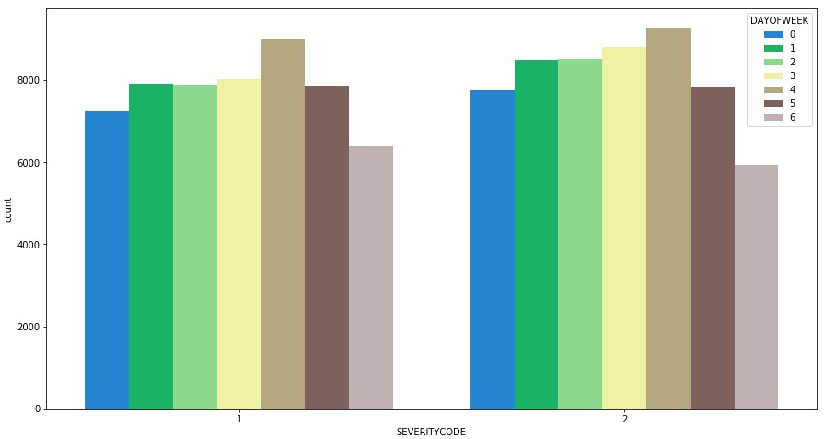
Relationship between day of the week of the accident and severity of accident

Slide 11
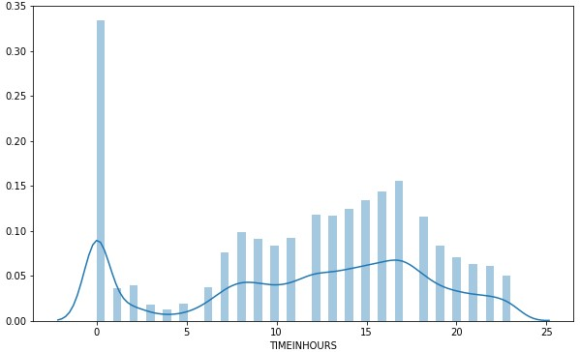
Relationship between hour of the accident and severity of accident:

Slide 12
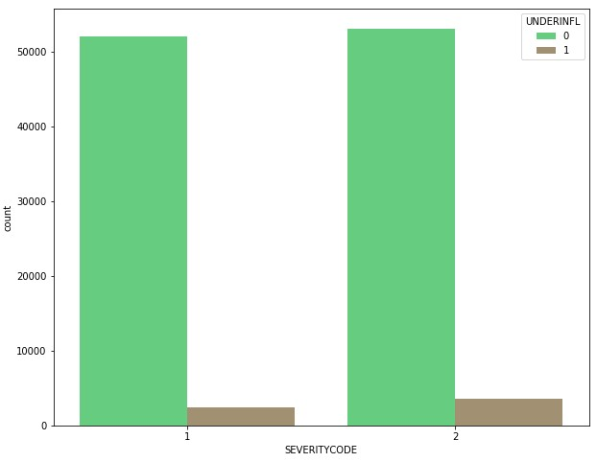
Relationship between driver under the influence of drug or alcohol and severity of accident:

Slide 13
Conclusion
Infrastructural factors like junction type – Effect severity of accident
Individual Situational factors like driver under influence of drug or alcohol – Have not significant effect on severity of accident
Cumulative situational factors like day of week and hours of day have effect on frequency of accidents.
Environmental factor like weather and lighting conditions – Not have any significant effect on frequency and severity of accidents.

